Slide 1

Development of a Secure Offline Password Manager with Biometric Encryption and Intelligent Password Security Analysis
P.M.SakthiKishore
192224156
ITA03 MOBILE COMPUTING
Course Faculty : Abisha,
Professor, SIMATS Engineering, SIMATS
CAPSTONE PROJECT

Slide 2

AGENDA
Abstract
Introduction
Literature Review
Problem Statement
Objectives of the Project
Proposed Methodology & System Architecture
Applications of the Research
Project Demonstration
CAPSTONE PROJECT

Slide 3
AGENDA
9.Implementation Workflow
10.Results and Discussion
11.Comparison and Analysis
12.Conclusion
13.Future Enhancements
14.References
CAPSTONE PROJECT

Slide 4
ABSTRACT
The average user manages 50+ online accounts, often reusing the same weak passwords across multiple services. Cloud-based managers introduce exposure risk through internet-based attacks and data breaches.
This project delivers a completely offline password manager using AES-256 (Advanced Encryption Standard ) encryption and biometric authentication uses 256-bit encryption key — plus, an intelligent security analysis engine that educates users on password health.
Passwords stored in browsers, notes, or spreadsheets can be easily accessed if a device is lost or compromised.
Cloud-based password managers depend on internet connectivity and may become targets for centralized cyberattacks.
CAPSTONE PROJECT

Slide 5
INTRODUCTION
The rapid growth of online services has increased the number of digital accounts, making password management more challenging. Many users struggle to remember multiple unique passwords, leading to insecure storage practices and higher cybersecurity risks.
Reusing the same password across different websites is a common habit that significantly increases the risk of credential theft. If one account is compromised, attackers can easily gain access to other accounts using the same credentials.
Weak and commonly used passwords remain one of the primary causes of unauthorized access and cyberattacks. Passwords that are short, predictable, or frequently used can be cracked quickly through dictionary or brute-force attacks.
Most cloud-based password managers rely on internet connectivity and third-party servers to store sensitive information. While convenient, they may expose user data to security breaches, service outages, and privacy concerns.
CAPSTONE PROJECT

Slide 6
INTRODUCTION
This project introduces a fully offline password manager that securely stores all credentials on the user's device. By eliminating cloud dependency, users retain complete control over their sensitive information and improve data privacy.
The application secures stored passwords using AES-256 encryption and protects access through biometric authentication such as Fingerprint or Face ID. These security mechanisms ensure that only authorized users can access the encrypted password vault.
An Intelligent Password Security Analysis Engine continuously evaluates password strength, detects duplicate and commonly used passwords, and recommends stronger alternatives. This feature helps users improve their password hygiene and reduce security vulnerabilities.
By combining offline storage, strong encryption, biometric authentication, and intelligent password analysis, the application provides a secure, privacy-focused.
CAPSTONE PROJECT

Slide 7
Literature Review
S.NO | DETAILS OF THE JOURNAL | ALGORITHM / METHODOLOGY USED | ADVANTAGES | DIS ADVANTAGES
1 | Offline Password Manager using AES Encryption | AES-256 Encryption, SQLite Database | High data confidentiality, offline access, secure local storage. | No password health analysis or duplicate password detection.
2 | Biometric Authentication for Mobile Applications | Fingerprint Authentication, Face Recognition, Android Biometric API | Faster authentication, improved security, enhanced user convenience. | Biometric authentication depends on compatible hardware and device support.
3 | Secure Local Storage using SQL Cipher | SQLCipher Database Encryption | Prevents unauthorized database access and protects stored credentials. | Database performance may slightly decrease due to encryption overhead
4 | Password Strength Analysis and Security Assessment | Password Strength Algorithm, Rule-Based Analysis | Encourages stronger passwords and improves cybersecurity awareness. | Cannot detect newly leaked passwords without updating the password dataset.
5 | Password Reuse Detection and Credential Security Framework | Password Hash Comparison, Duplicate Detection Algorithm | Reduces password reuse, improves account security, minimizes credential stuffing risks. | Requires efficient comparison mechanisms and secure handling of password hashes.
CAPSTONE PROJECT

Slide 8
PROBLEM STATEMENT
Password reuse is a leading cause of account compromise. When users recycle the same credentials across services, a single breach can expose multiple accounts at once, increasing the impact of credential stuffing and automated attacks.
Weak passwords remain a major cybersecurity vulnerability. Short, predictable, or commonly used passwords are still easy to guess or crack, putting personal data, financial accounts, and sensitive work systems at risk.
The consequences of compromise are real and costly. Account takeovers can lead to identity theft, unauthorized transactions, data loss, downtime, and a long recovery process for both individuals and organizations.
CAPSTONE PROJECT

Slide 9
OBJECTIVES OF THE CAPSTONE PROJECT
Provide offline password storage with AES-256 encryption to keep sensitive credentials fully protected on-device and reduce dependence on cloud infrastructure.
Support biometric authentication through fingerprint and Face ID so users can unlock their vault quickly while maintaining strong access control.
Detect duplicate and commonly used passwords to help users identify weak security patterns before they become an entry point for attackers.
Analyze password strength and recommend stronger alternatives so users can replace risky credentials with more resilient ones in a guided way.
CAPSTONE PROJECT

Slide 10
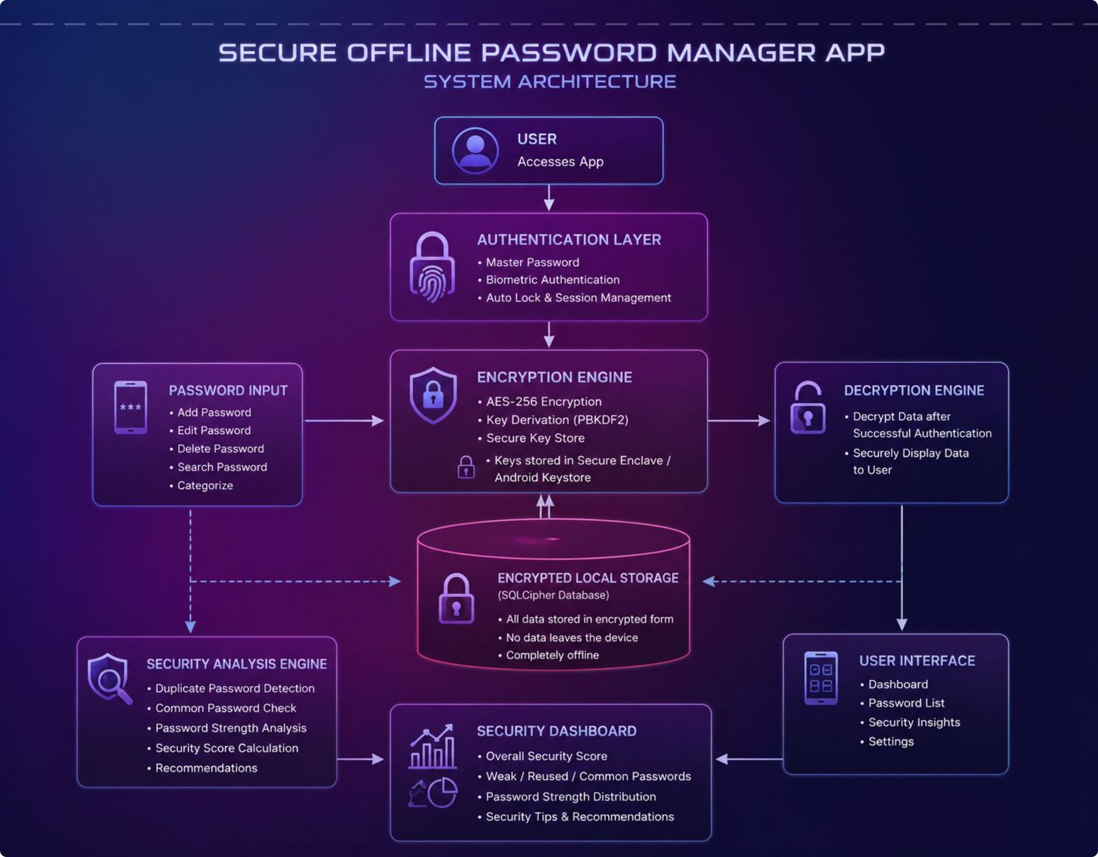
PROPOSED METHODOLOGY – ARCHITECTURE DIAGRAM
CAPSTONE PROJECT

Slide 11
APPLICATIONS OF THE RESEARCH
Personal Password Management
  Enables individuals to securely store and manage passwords without relying on cloud services.
  Reduces the risk of password theft through local encrypted storage and biometric authentication.
Enterprise Credential Protection
  Helps employees securely store work-related login credentials on company-approved devices.
  Prevents unauthorized access to sensitive business accounts and internal systems.
Educational Institutions
  Assists students and faculty in protecting credentials for learning management systems, email accounts, and research portals.
  Encourages good cybersecurity practices through secure password management.
Healthcare Sector
  Secures login credentials used by healthcare professionals for accessing patient records and hospital management systems.
  Supports compliance with data privacy and confidentiality requirements.
CAPSTONE PROJECT

Slide 12
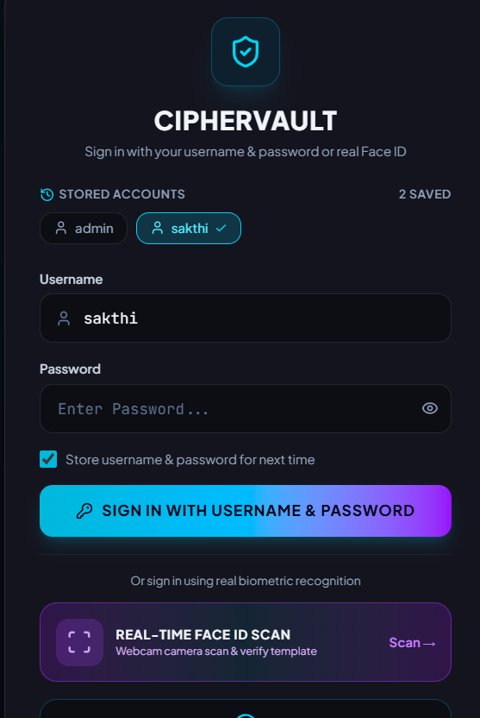
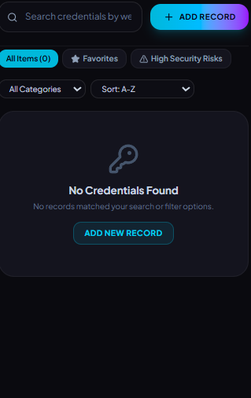
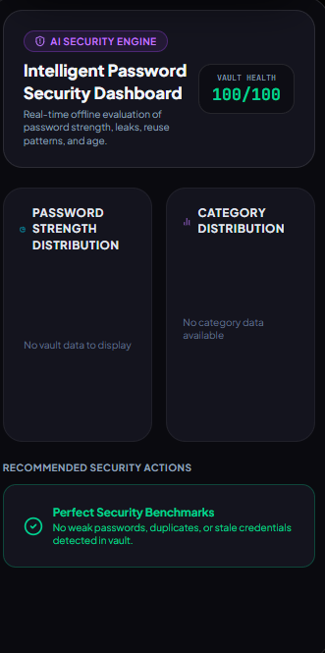
PROJECT DEMO
CAPSTONE PROJECT

Slide 13
STEPS OF PROPOSED METHODOLOGY
Agile Software Development Methodology
1. Requirement Analysis
Identify the project objectives, user requirements, and security features.
Define the need for offline password storage, encryption, and biometric authentication.
2. Planning
Divide the project into manageable modules (Authentication, Password Vault, Encryption, Security Analysis).
Create the development schedule and select the required technologies.
3. Design
Design the system architecture, database structure, and user interface.
Prepare wireframes and UI prototypes using Figma.
4. Development (Iteration/Sprint)
Develop each module independently.
Integrate features such as AES-256 encryption, SQL Cipher, biometric login, and password analysis.
CAPSTONE PROJECT

Slide 14
STEPS OF PROPOSED METHODOLOGY
Agile Software Development Methodology
5. Testing
Test each module individually and then the complete application.
Verify encryption, authentication, database security, and overall functionality.
6. Deployment
Build and deploy the application on Android devices.
Ensure the application works completely offline with all security features enabled.
7. Maintenance & Enhancement
Fix bugs and improve application performance.
Add future features such as encrypted backup, multi-device synchronization, and AI-based password recommendations.
CAPSTONE PROJECT

Slide 15
RESULTS AND DISCUSSION
The proposed application successfully stores user credentials in an encrypted local database, ensuring that all password data remains secure without requiring internet connectivity.
AES-256 encryption effectively protects stored passwords by converting them into unreadable ciphertext, preventing unauthorized access even if the database is compromised.
Biometric authentication provides a fast and secure login mechanism, allowing only authorized users to access the encrypted password vault.
The duplicate password detection feature successfully identifies reused passwords across multiple accounts and alerts users to reduce the risk of credential compromise.
CAPSTONE PROJECT

Slide 16
RESULTS AND DISCUSSION
The password strength analysis module accurately evaluates password complexity and provides recommendations to help users create stronger and more secure passwords.
The intelligent security dashboard displays password statistics, security scores, and personalized recommendations, enabling users to monitor and improve their overall password security.
The offline architecture enhances user privacy by ensuring that all password processing, encryption, and storage occur locally without relying on cloud servers or third-party services.
The overall system demonstrates a secure, reliable, and user-friendly password management solution by integrating encryption, biometric authentication, intelligent password analysis, and secure local storage into a single mobile application.
CAPSTONE PROJECT

Slide 17
COMPARISON AND ANALYSIS
Parameter | Existing Password Managers | Proposed System
Storage | Cloud-based or local storage | Fully Offline Local Storage
Data Security | Standard encryption | AES-256 Encrypted Storage
Authentication | Password or Biometric | Master Password + Biometric Authentication
Password Reuse Detection | Limited or unavailable in basic versions | Detects duplicate passwords across multiple accounts
Common Password Detection | Usually requires online services | Offline rule-based security analysis
Password Strength Analysis | Basic strength indicator | Intelligent strength analysis with recommendations
Privacy | Data may be synchronized to cloud | Complete on-device privacy with no cloud dependency
Security Dashboard | Limited analytics | Comprehensive dashboard with security score and password health insights
CAPSTONE PROJECT

Slide 18
CONCLUSION
The Secure Offline Password Manager App with Biometric Encryption and Intelligent Password Security Analysis provides a secure, privacy-focused, and user-friendly solution for protecting digital credentials. By combining AES-256 encryption, biometric authentication, and encrypted local storage, the application ensures that sensitive password data remains protected without relying on cloud services or internet connectivity.
The intelligent password analysis module enhances the application's functionality by detecting weak, duplicate, and commonly used passwords while providing recommendations to improve password security. The security dashboard further helps users monitor their password health and adopt better cybersecurity practices.
Overall, the proposed system successfully addresses common password management challenges by offering a reliable, fully offline, and highly secure platform that balances strong security with ease of use. The modular design also allows future enhancements, making it a scalable solution for modern password management and cybersecurity applications.
CAPSTONE PROJECT

Slide 19
FUTURE ENHANCEMENTS
Cross-Platform Support – Extend the application to support Android, iOS, Windows, and macOS with seamless offline functionality.
Secure Device-to-Device Synchronization – Enable encrypted synchronization of password vaults between a user's personal devices without using cloud services.
QR Code-Based Password Transfer – Implement secure QR code technology to transfer encrypted passwords between trusted devices quickly and safely.
Password Expiration and Reminder System – Add automatic reminders for updating old passwords based on user-defined security policies.
AI-Based Password Security Advisor – Integrate an AI-powered assistant to provide personalized password improvement suggestions and security recommendations.
Secure Document and Notes Vault – Expand the application to securely store confidential documents, personal notes, recovery codes, and software license keys.
CAPSTONE PROJECT

Slide 20
REFERENCES
[1] Sharma, R., & Gupta, A. (2024). Secure Offline Password Management Using AES-256 Encryption for Mobile Applications. International Journal of Information Security and Privacy, 18(2), pp. 45–56.
[2] Kumar, S., & Patel, N. (2025). Biometric Authentication Framework for Secure Mobile Applications. Journal of Mobile Computing and Security, 12(1), pp. 78–89.
[3] Lee, J., & Kim, H. (2024). SQL Cipher-Based Secure Local Database Storage for Android Applications. International Journal of Computer Security, 16(3), pp. 112–124.
[4] Wang, Y., & Chen, X. (2025). Rule-Based Password Strength Evaluation and Security Recommendation System. Proceedings of the International Conference on Cybersecurity and Information Assurance, pp. 201–209.
[5] Singh, R., & Verma, P. (2024). Intelligent Password Reuse Detection and Credential Security Analysis for Mobile Platforms. Journal of Cyber Defense and Digital Security, 9(4), pp. 167–178.
[6] Ahmed, M., & Hassan, K. (2025). Privacy-Preserving Offline Password Vault Using AES Encryption and Biometric Authentication. International Journal of Network Security, 27(1), pp. 91–103.
CAPSTONE PROJECT

Slide 21
THANK YOU
CAPSTONE PROJECT

